Slide 1
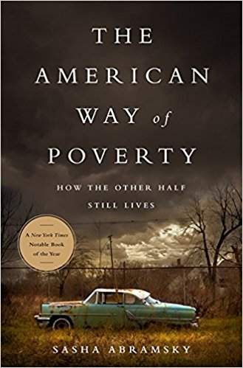
Dallas Public Library July 26, 2018
Hard Conversations: The American Way of Poverty
MDHA, CitySquare, and the Dallas Public Library present a book synopsis of Sasha Abramsky’s The American Way of Poverty: How the Other Half Still Lives

Slide 2
Dallas Public Library July 26, 2018

Slide 3
The Rule of Seventeen

Slide 4
A “lesson” about what’s “news”
almost without exception, every single time we’ve covered climate change it’s been a palpable ratings killer, so the incentives are not great.
• Chris Hayes, MSNBC anchor, in a Tweetet

Slide 5
Let’s stop and think
• There are poor people in Dallas

Slide 6
Let’s stop and think
• There are poor people in Dallas
• There is a great divide in Dallas

Slide 7
Let’s stop and think
• There are poor people in Dallas
• There is a great divide in Dallas
• The number of poor people in Dallas is large, and not appreciably shrinking

Slide 8
Let’s repeat…
• There are poor people in Dallas
• There is a great divide in Dallas
• The number of poor people in Dallas is large, and not appreciably shrinking

Slide 9
Spread the word…
• There are poor people in Dallas
• There is a great divide in Dallas
• The number of poor people in Dallas is large, and not appreciably shrinking

Slide 10
REMEMBER!
• There are poor people in Dallas
• There is a great divide in Dallas
• The number of poor people in Dallas is large, and not appreciably shrinking

Slide 11
Have you got it now?
• There are poor people in Dallas
• There is a great divide in Dallas
• The number of poor people in Dallas is large, and not appreciably shrinking

Slide 12
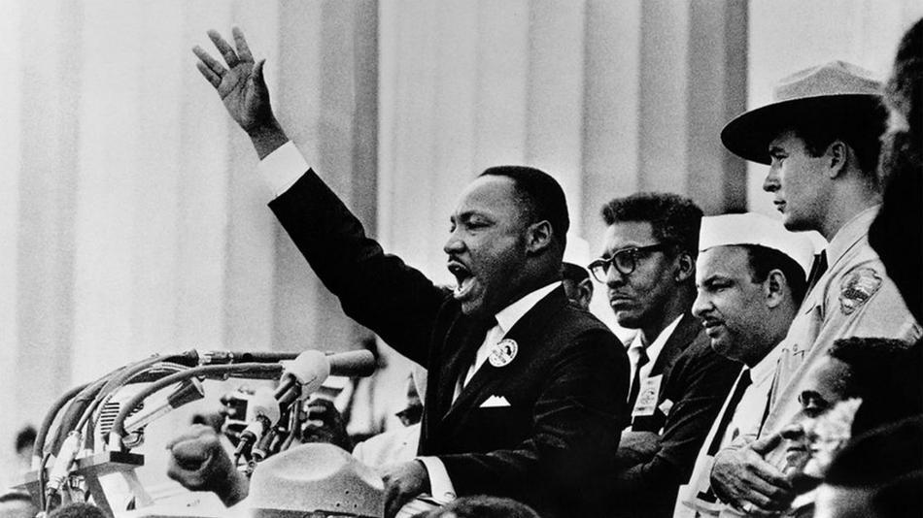
One hundred years later, the negro
lives on a lonely island of poverty
in the midst of a vast ocean
of material prosperity.
Martin Luther King, Jr.
August 28, 1963

Slide 13
Poverty in Dallas

Slide 14
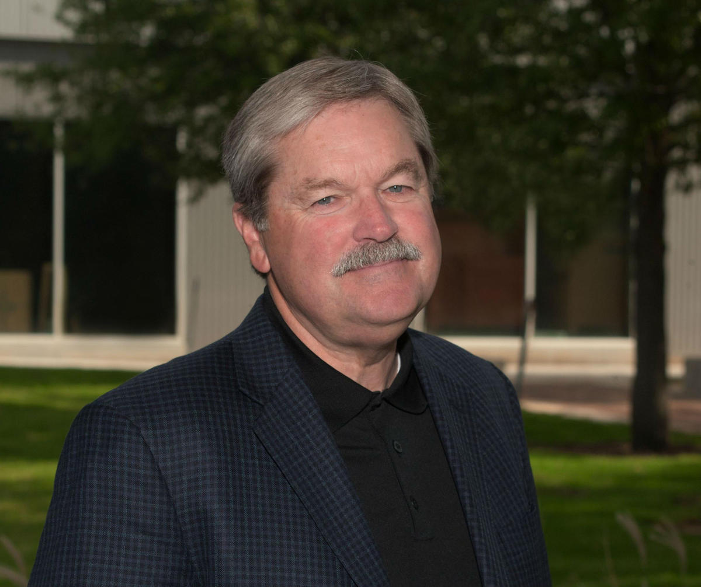
“It’s not acceptable for a city
as full of wealth
and opportunity as Dallas
to be ranked third or fourth
poorest urban center in
the United States
behind Detroit,
Memphis & Philadelphia”
Larry James
CitySquare

Slide 15
The United States near the top…

Slide 16
Dallas Public Library July 26, 2018
Hard Conversations: The American Way of Poverty
MDHA, CitySquare, and the Dallas Public Library present a book synopsis of Sasha Abramsky’s The American Way of Poverty: How the Other Half Still Lives

Slide 17
About that rule of 17 – and books…

Slide 18
We meet every third Thursday – come join us!

Slide 19
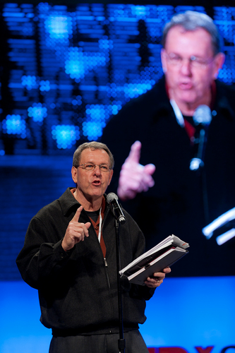
Randy Mayeux
Randy Mayeux
Dallas Texas
firstfridaybooksynopsis.com
15minutebusinessbooks.com

