Slide 1
Homeless Solutions
Proposed Strategy
CoC General Assembly Meeting
July 17, 2018
Monica Hardman
Managing Director
Office of Homeless Solutions
Nadia Chandler Hardy
Chief of Community Services

Slide 2
Agenda
Welcome and Introductions
Office of Homeless Solutions Mission
State of Homelessness in the City of Dallas
Overview of proposed Homeless Solutions Strategy Plan
Next Steps
Appendix
Notes:
Welcome and Format of Meeting (discuss purpose of public engagement & outreach, ways in which to submit feedback)
Introduction of Key Stakeholders (OHS, CHC, City Council, the Partnership, etc.)

Slide 3
Office of Homeless Solutions
Established by the Dallas City Council on October 1, 2017
Mission: To positively impact the quality of life in the City of Dallas through innovative, collaborative, and comprehensive solutions for homelessness.
Prevent homelessness
Protect persons experiencing homelessness
Promote affordable housing solutions
Partner to maximize resources
Notes:
The Office of Homeless Solutions (OHS) was established on October 1, 2017, to prevent and intervene in homelessness by combating the complexity of homelessness with innovative and effective solutions. Additionally, OHS is charged with providing the leadership and coordination to promote collaborative efforts of private and public partners, ultimately creating policy and solidifying a diverse funding portfolio to adequately address homelessness.
Through innovation, collaboration, and comprehensive strategies, the Office of Homeless Solutions strives to positively impact quality of life in the City of Dallas by preventing homelessness, advocating for those experiencing homelessness, promoting affordable housing opportunities, and partnering to maximize resources (talking points, insert graphic from strategic plan here)

Slide 4
State of Homelessness
2018 Point In Time PIT Count Results for City of Dallas:
3,506 homeless identified (9% increase from 2017)
1,098 unsheltered homeless (24% increase from 2017)
Shelter demand exceeds capacity
4

Slide 5
State of Homelessness

Slide 6
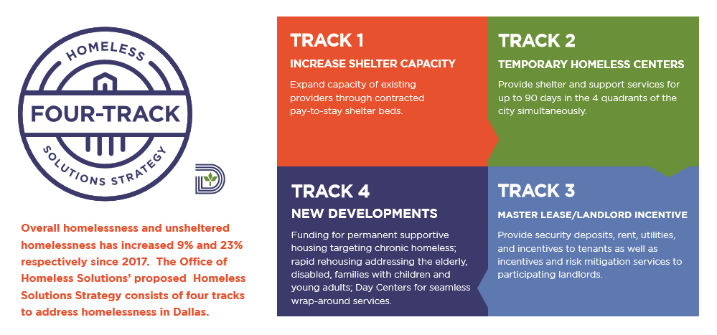
Homeless Solutions Strategy Plan

Slide 7
Target Population: Chronically Homeless
Strategy | Metrics | City Council Action Required (proposed for August 2018)
Provide access to an additional 150 shelter beds City to pay $12 per night per bed Provide shelter beds for unsheltered homeless for up to 90 days Direct referrals from OHS staff Efforts to address shelter-resistant homeless population | Number of referrals Number of housing plans developed Percent exited to housing Shelter bed utilization rate | Consideration of Dallas Life contract Consideration of The Bridge contract amendment

Slide 8
Target Populations: Elderly (55+), veterans, disabled, families with children, transitional aged youth (18-24)
Strategy | Metrics | City Council Action Required (proposed for August 2018)
Decentralize shelter beds and services Serve up to 800 unsheltered (up to 50 per site) over 12 months Focus on intense case management OHS staff to provide referrals Leverage private partnerships through RFCSP Public participation & outreach Good Neighbor Pledges | Number of referrals Number of housing plans developed Percent exited to housing Average length of stay Number of unduplicated clients served Number of program enrollments (job-training, education, etc.) | Consideration of proposed City Code amendments FY19 Budget enhancement approval of $2,100,000
Notes:
Focus on intense case management
DARS (Dept. of Assistive & Rehabilitative Services)
GED classes
Intensive Outpatient Programs
Texas Workforce Commission
CitySquare certifications
Up to 4 THC’s during normal weather. Maximum of 10 THC during inclement weather.
Competitive RFP process for operations/management, case management and wrap around services, and all contracted services
Chapter 51 – Zoning
Creation of chapter (possibly 45) that details operations of temporary homeless centers
THC sites selected and eligibility confirmed through permitting process
Vendors selected through RFP for contracted services (operations, security, transportation, meals, case management, workforce/job training, sanitation, storage, etc.)

Slide 9
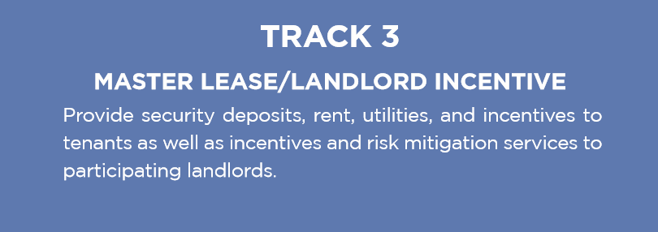
Target Populations: sheltered persons on the housing priority list
Strategy | Metrics | City Council Action Required (proposed for August 2018)
Reduce bottleneck and length of time for clients/families to be placed in housing Serve 100 clients/families over 12 month period Master lease program with housing providers Site selection criteria developed in partnership with Citizen Homelessness Commission | Number of unduplicated clients assisted with security and/or utility deposits Number of unduplicated clients assisted with rental subsidy | Consideration of Master Lease contract FY19 Budget enhancement approval of $1,300,000
Notes:
OHS Action - Negotiation to finalize agreement with Apartment Association, other private property owners, and Dallas Housing Authority
Master lease program with Apartment Association, other private property owners, and Dallas Housing Authority to have units set-aside for homeless as well as rental assistance

Slide 10
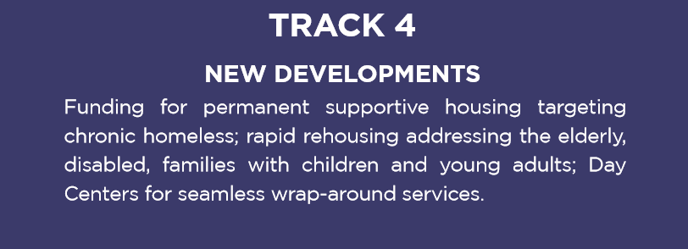
Target Populations: sheltered persons on the housing priority list
Strategy | Metrics | City Council Action Required
Implementation of $20 million Bond Program approved by voters Creation of 1,000 housing units over next 3-5 years Creation of NOFA criteria in partnership with Citizen Homelessness Commission Work with the Dallas Area Partnership to Prevent and End Homelessness to create private investment strategies | Number of housing units created Number of Day Centers created Amount of private dollars leveraged | Consideration of NOFA Awards
Notes:
First release of NOFA application in Fall 2018
Competitive RFP process through Notice of Funding Availability

Slide 11
Next Steps
Community Engagement Meetings
Round 2 once locations designated by OHS
Homeless Providers Engagement Meetings
City Council Briefing August 1, 2018
Advocate, Advocate, Advocate
Possible City Council Voting Agenda August 22, 2018
Tentative implementation August 2018

Slide 12
Homeless Solutions
Proposed Strategy
CoC General Assembly Meeting
July 17, 2018
Monica Hardman
Managing Director
Office of Homeless Solutions
Nadia Chandler Hardy
Chief of Community Services

